Slide 1
NATURAL LANGUAGE PROCESSING
By : Prof.(Dr.) Archana Singh

Slide 2
Introduction
Language is a method of communication with the help of which we can speak, read and write. Natural Language Processing (NLP) is a subfield of Computer Science that deals with Artificial Intelligence (AI), which enables computers to understand and process human language.
Natural Language Processing (NLP) is the sub-field of Computer Science especially Artificial Intelligence (AI) that is concerned about enabling computers to understand and process human language. Technically, the main task of NLP would be to program computers for analyzing and processing huge amount of natural language data.

Slide 3
Syllabus – Unit I
Introduction of Vectors, Word Analogy, Assess Word Vectors using TF-IDF and t-SNE, word vectors from GloVe, word vectors from word2vec, Text Classification with Word Vectors, Basics of Theano and Tensorflow

Slide 4
Topics
Raw data processing (Data cleaning)
2. Tokenization and StopWords
3. Feature Extraction techniques
4. Topic Modelling and LDA
5.Word2Vec (word embedding)
6. Continuous Bag-of-words(CBOW)
7. Global Vectors for Word Representation (GloVe)
8. text Generation,
9. Transfer Learning

Slide 5
Prerequisite: Python Basic Understanding
Libraries Used: Keras, Tensorflow, Scikit learn, NLTK, Glove, etc.

Slide 6

Steps OF TEXT MINING
Step 1: Data Cleaning
The raw text data comes directly after the various sources are not cleaned. We apply multiple steps to make data clean. Un-cleaned text data contains useless information that deviates results, so it’s always the first step to clean the data.
Some standard preprocessing techniques should be applied to make data cleaner. Cleaned data also prevent models from overfitting.

Slide 7
NLP - Introduction
Natural Language Processing is a part of computer science that allows computers to understand language naturally, as a person does.
This means the laptop will comprehend sentiments, speech, answer questions, text summarization, etc.

Slide 8
Vectors
Word Embeddings or Word vectorization is a methodology in NLP to map words or phrases from vocabulary to a corresponding vector of real numbers which used to find word predictions, word similarities/semantics.
The process of converting words into numbers are called Vectorization.
Word embeddings help in the following use cases.
Compute similar words
Text classifications
Document clustering/grouping
Feature extraction for text classifications
Natural language processing.

Slide 9
Similarity measure
After the words are converted as vectors, we need to use some techniques such as Euclidean distance, Cosine Similarity to identify similar words.
Why Cosine Similarity
Count the common words or Euclidean distance is the general approach used to match similar documents which are based on counting the number of common words between the documents.
This approach will not work even if the number of common words increases but the document talks about different topics. To overcome this flaw, the “Cosine Similarity” approach is used to find the similarity between the documents.

Slide 10
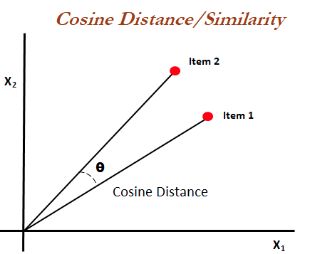
Cosine Similarity
Mathematically, it measures the cosine of the angle between two vectors (item1, item2) projected in an N-dimensional vector space.
The advantageous of cosine similarity is, it predicts the document similarity even Euclidean is distance.
“Smaller the angle, the higher the similarity” — Cosine Similarity.

Slide 11
Example
Let’s see an example.
Julie loves John more than Linda loves John
Jane loves John more than Julie loves John
John 2 2
Jane 0 1
Julie 1 1
Linda 1 0
likes 0 1
loves 2 1
more 1 1
than 1 1
the two vectors are,
Item 1: [2, 0, 1, 1, 0, 2, 1, 1]
Item 2: [2, 1, 1, 0, 1, 1, 1, 1]

Slide 12
Sentences into vectors
The cosine angle (the smaller the angle) between the two vectors' value is nearest to 1.
Now let’s see what are all the ways to convert sentences into vectors.
Word embeddings coming from pre-trained methods such as,
Word2Vec — From Google
Fasttext — From Facebook
Glove — From Standford

Slide 13
Why Word2Vec technique is created:
Most of the NLP systems treat words as atomic units. There is a limitation of the existing systems that there is no notion of similarity between words. Also, the system works for small, simpler and outperforms on less data which is only a few billions of data or less.
In order to train with a larger dataset with complex models, the modern techniques use a neural network architecture to train complex data models and outperforms for huge datasets with billions of words and with millions of words vocabulary.

Slide 14
Regularities
This technique helps to measure the quality of the resulting vector representations. This works with similar words that tend to close with words that can have multiple degrees of similarity.
Syntactic Regularities: Refers to grammatical sentence correction.
Semantic Regularities: Refers to the meaning of the vocabulary symbols arranged in that structure.

Slide 15
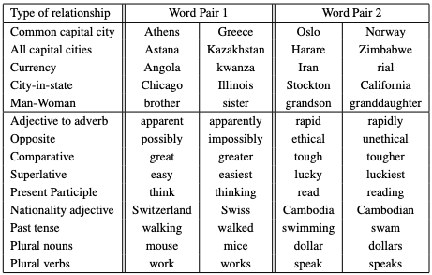
Five Syntactic and Semantic word relationship test set.

Slide 16
Similarity of words
The proposed technique was found that the similarity of word representations goes beyond syntactic regularities and works surprisingly good for algebraic operations of word vectors. For example,
Vector(“King”) — Vector(“Man”)+Vector(“Woman”) = Word(“Queen”)
where “Queen” is the closest result vector of word representations.

Slide 17
Neural Network MODELs
The following model architectures for word representations' objectives are to maximize the accuracy and minimize the computation complexity. The models are
FeedForward Neural Net Language Model (NNLM)
Recurrent Neural Net Language Model (RNNLM)
All the above-mentioned models are trained using Stochastic gradient descent and backpropagation.

Slide 18
FeedForward Neural Net Language Model (NNLM)
The NNLM model consists of input, projection, hidden and output layers. This architecture becomes complex for computation between the projection and the hidden layer, as values in the projection layer dense.
Recurrent Neural Net Language Model (RNNLM)
RNN model can efficiently represent more complex patterns than the shallow neural network. The RNN model does not have a projection layer; only input, hidden and output layer.

Slide 19
Modelling of words
Models should be trained for huge datasets using a large-scale distributed framework called DistBelief, which would give better results. The proposed new two models in Word2Vec such as,
Continuous Bag-of-Words Model
Continuous Skip-gram Model
uses distributed architecture which tries to minimize computation complexity.

Slide 20
Continuous Bag-of-Words Model
We denote this model as CBOW. The CBOW architecture is like the feedforward NNLM, where the non-linear hidden layer is removed, and the projection layer is shared for all the words; thus, all words get projected into the same position.
Continuous Skip-gram Model
The skip-gram model is like CBOW. The only difference is instead of predicting the current word based on the context, it tries to maximize the classification of a word based on another word in the same sentence

Slide 21
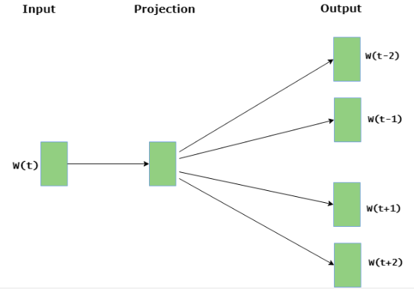
Skip-gram architecture predicts surrounding words given the current word

Slide 22
Word2Vec
Word2Vec Architecture Implementation — Gensim
Gensim library will enable us to develop word embeddings by training our own word2vec models on a custom corpus with CBOW of skip-grams algorithms.
The implementation library can be found here — https://bit.ly/33ywiaW

Slide 23
Summary
Natural Language Processing requires texts/strings to real numbers called word embeddings or word vectorization
Once words are converted as vectors, Cosine similarity is the approach used to fulfill most use cases to use NLP, Documents clustering, Text classifications, predicts words based on the sentence context
Cosine Similarity — “Smaller the angle, higher the similarity
Most famous architectures such as Word2Vec, Fasttext, Glove helps to converts word vectors and leverage cosine similarity for word similarity features
NNLM, RNNLM outperforms for the huge dataset of words. But computation complexity is a big overhead

Slide 24
Summary (contd…)
NNLM, RNNLM outperforms for the huge dataset of words. But computation complexity is a big overhead
To overcome the computation complexity, the Word2Vec uses CBOW and Skip-gram architecture in order to maximize the accuracy and minimize the computation complexity
CBOW architecture predicts the current word based on the context
Skip-gram architecture predicts surrounding words given the current word

Slide 25
Visualizing Word Vectors with t-SNE
TSNE is useful when it comes to visualizing similarity between objects. It works by taking a group of high-dimensional (100 dimensions via Word2Vec) vocabulary word feature vectors, then compresses them down to 2-dimensional x,y coordinate pairs. The idea is to keep similar words close together on the plane, while maximizing the distance between dissimilar words.
Steps
Clean the data
Build a corpus
Train a Word2Vec Model
Visualize t-SNE representations of the most common words

Slide 26
Word Embeddings
Word Embeddings
The word embedding techniques are used to represent words mathematically. One Hot Encoding, TF-IDF, Word2Vec, FastText are frequently used Word Embedding methods. One of these techniques (in some cases several) is preferred and used according to the status, size and purpose of processing the data.

Slide 27
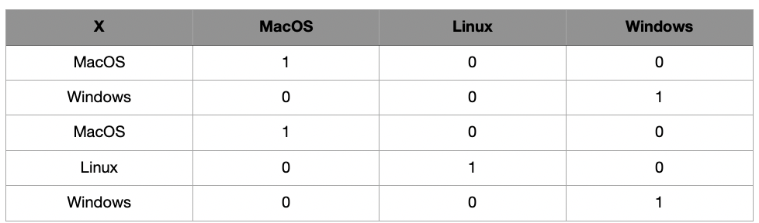
One Hot Encoding
One of the most basic techniques used to represent data numerically is One Hot Encoding technique[1]. In this method, a vector is created in the size of the total number of unique words. The value of vectors is assigned such that the value of each word belonging to its index is 1 and the others are 0. As an example, Figure 1 can be examined.

Slide 28
Word Embeddings
Word embeddings is the process by which words are transformed into vectors of real numbers.
Why do we need that? Well, most of the algorithms in machine learning cannot process strings or plain text in their raw form. Instead, they require numbers as inputs to be able to function. By transforming words into vectors, word embeddings therefore allows us to process the huge amount of text data and make them fit for machine learning algorithms.

Slide 29
How does it work?
One of the most basic ways to transform words into numbers is through the one-hot encoding method.
Consider the sentence: “I am learning how word embeddings work”. The words in this sentence are “learning”, “embeddings” etc. From this, we can create a dictionary which is the list of all unique words in the sentence.
In this case: [“I”, “am”, “learning”, “how”, “word”, “embeddings”, “work”].
A one-hot encoded vector representation of a word can be encoded in a way that 1 stands for the position where the word exists and 0 everywhere else.
For instance, the vector representation of “learning” is as follows: [0, 0, 1, 0, 0, 0, 0]. As a result, each word will have its unique dimension.

Slide 30
Vector Space
In addition, they are mapped into a vector space. Why?
The idea behind it is that words with similar context occupy close spatial positions.
In other words, words used in a similar context are close to each other
while words that aren’t are far away from each other in the vector space

Slide 31
TF-IDF
While TF-IDF relies on a sparse vector representation,
GloVe belongs to the dense vector representations.

Slide 32
Sparse vectors: TF-IDF
TF-IDF follows a similar logic than the one-hot encoded vectors explained above. However, instead of only counting the occurrence of a word in a single document it also does so in relation to the entire corpus. This allows us to detect how important a word is to a document in a corpus.
What does this mean? Well, common words such as “the” or “a” will appear very frequently in almost every document. However, other words might appear frequently in only one or two documents and those are the ones that are likely to be more representative of the document they are present in.

Slide 33
TF-IDF
TF-IDF aims to put this into light: weigh down the common words that occur in almost every document (e.g. “the” or “a”) and give more importance to those that appear only in a few documents.
In detail, TF IDF is composed of two parts: TF which is the term frequency of a word, i.e. the count of the word occurring in a document and IDF, which is the inverse document frequency, i.e. the weight component that gives higher weight to words occurring in only a few documents.

Slide 34
Dense vectors: GloVe
Dense vectors fall into two categories: matrix factorization and neural embeddings. GloVe belongs to the latter category, alongside another popular neural method called Word2vec.
In a few words, GloVe is an unsupervised learning algorithm that puts emphasis on the importance of word-word co-occurences to extract meaning rather than other techniques such as skip-gram or bag of words. The idea behind it is that a certain word generally co-occurs more often with one word than another. The word ice is more likely to occur alongside the word water for instance.

Slide 35
Word embeddings in application
Finding the degree of similarity between two words
Once you have transformed words into numbers, you can use similarity measures to find the degree of similarity between words.
cosine similarity, measures the orientation and not the magnitude, i.e. vectors that are similar will have a similar vector orientation. In more detail, this means that two vectors with the same orientation will have a cosine similarity of 1, two vectors oriented at 90° relative to each other will have a similarity of 0, and two vectors diametrically opposed have a similarity of -1. And this is completely independent of their magnitude.

Slide 36
Similarity measure
Finding the similarity between words can lead to powerful insights. In marketing, this can help marketers understand to which words a specific product is associated with by consumers.
As a result, this can help develop more efficient advertising campaigns with targeted search queries. In a similar way, this can also inform communication experts or politicians in the development of audience targeted campaigns.

Slide 37
Corpora
Comparing the use of a word across different corpora
Related to the above, one can also focus on the use of a specific word and use the measure of cosine similarity to understand how this word is used differently across different corpora. For instance, you can compare the use of the word “climate” across various UN speeches or the context of the word “immigration” across Republican and Democrat manifestos. From this you can extract party or even policy differences.

Slide 38
Word Analogies
Analyse amazing things like woman + king — man =queen
Word analogies are the true fun part of word embeddings! They allow you to make deductions in the form of: “a is to b” what “x is to y”.
Here’s an example: king — man+ woman= queen. In other words, adding the vectors king and woman while substracting man gives us the vector associated with queen. In plain English, this means: a king is to a man what a queen is to a woman.

Slide 39
Word2VEc
As humans, we know that king relates to a male figure while queen refers to a female figure. Word embeddings allow computers to understand this too by taking the difference between the vector representations of king and man. If one tries to project the woman vector through the same direction, one will thus get the word queen. The information that queen is the feminine of king has never been fed directly to the model, but the model is able to capture the relation through word embeddings.
Another example is: paris — france +germany = berlin. In other words, Paris is to France what Berlin is to Germany!
Here again, text2vec is an easy to use package in R to perform these word analogies from the GloVe algorithm with the measure of cosine similarity

Slide 40
Language is a powerful means through which race, gender discrimination and stereotypical biases are reproduced. It is therefore crucial to consider the implication that these biases could have on automated tasks which are based on processing human language.
How and why is this a problem?
Consider implementing machine learning algorithms based on word embeddings in environments such as job recruitment processes or translation services. In these cases, stereotypes can strike in and actually implify discrimination towards one group. A popular example given in this case is the relation between man:programmer = female, which will yield the result homemaker.
The embedding model will see programmer closer with male than female because of our own social perception we have of this job which is reflected in the language we use.

Slide 41
Another example can be taken from automation in cv scanning.
Let’s assume the company decided to train the word embeddings on a large dataset such as Wikipedia for instance. Chances to find positive adjectives like crafty, brilliant and clever in a motivation letter are high, but it was also found that these terms were closer to man than to woman in the pretrained embedding space. This gender bias will therefore be reproduced in the automated task.
Gender inequality, race discrimination and other stereotypical biases are deeply rooted in our society and our use of the language. As such, the application of machine learning algorithms on this language runs the risk of propagating and amplifying all these biases. Algorithm are therefore never ‘neutral’ because our language itself is not neutral.

Slide 42
Final Remarks
Word embeddings appear everywhere in our daily interaction with computers. They can deliver insights that go beyond their mere application in data science, touching upon the realms of marketing, communications, politics and policy-making. Identifying word similarities and analogies are examples of their powerful application. Nonetheless, their application is never neutral and, as with any algorithm, always make sure to consider their ethical implications!

